Slide 1
SMART HOME AUTOMATION PROJECT
PROJECT TITLE :- AUTOMATIC ROOM LIGHT USING IR SENSOR
By - katyayini baranwal

Slide 2
What is smart home automation?
Smart home automation is a technology that automates daily hometasks.
It increases comfort ,safety, and energy efficiency.
Examoles are : automatically turning on lights , fans,etc.
In this project you will see how our project automates light using an ir sensor.

Slide 3
What is the aim of this project?
It detects human presence with ir sensor.
It also turns on the lights automatically room light when someone enters the rooms .
It also turns off the lights automatically when no presence is detected.
It is very simple and energy efficient automation.

Slide 4
Components required.
aurdino uno
ir sensor module
Led(light)
resistor
Jumper wires
BATTERY

Slide 5
Working principle – how it works ?
In this system ir sensor detects the object with range .
Then the Arduino reads signal from ir sensor.
If low (object detected) then the bulb will turn on.
If high(no object detected)then bulb will turn off.

Slide 6
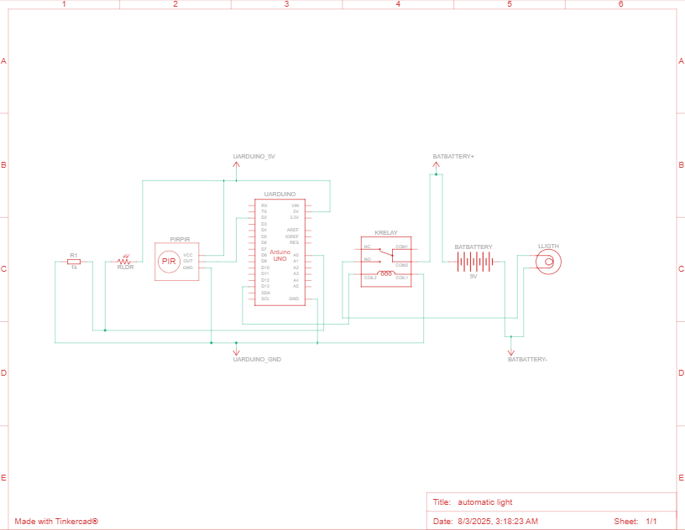
Schematic circuit diagram

Slide 7
Code used for the project
//#include
int bulb = 13;
int inputPir = 2;
int val = 0;
int hasilSensorLDR;
int sensorLDR = A0;
void setup() {
pinMode(bulb, OUTPUT);
pinMode(inputPir, INPUT);
pinMode(sensorLDR, INPUT);
Serial.begin(9600);
}

Slide 8
void loop(){
val = digitalRead(inputPir);
hasilSensorLDR = analogRead(sensorLDR);
if (hasilSensorLDR<600){
if (val == HIGH) {
digitalWrite(bulb, HIGH);
delay(1000);
}
else {
digitalWrite(bulb, LOW);
delay(300);
}
}
else{ digitalWrite(bulb,LOW);
Serial.println(hasilSensorLDR);
delay(500);
}
}

Slide 9
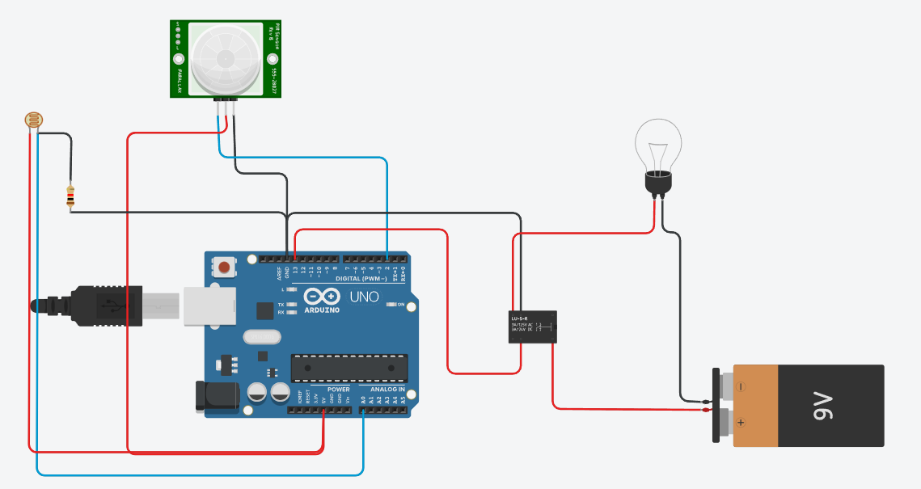
Circuit diagram before stimulation

Slide 10
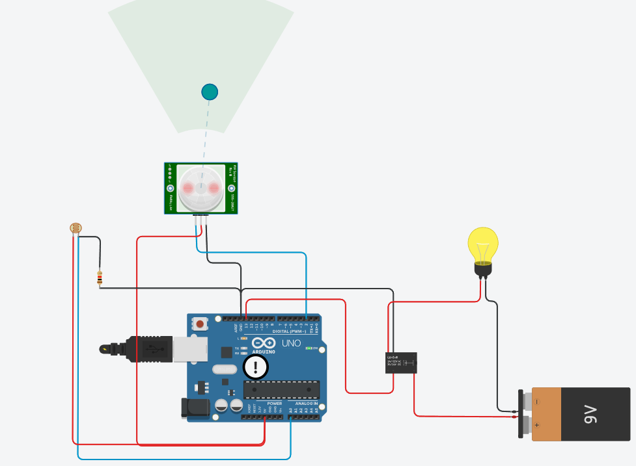
Circuit diagram after stimulation

Slide 11
Benefits of this system
It is hands free and touchless operation
Its is also a power saving automation
It is easy to build and maintain
Cost effective and scalable

Slide 12
THANK YOU

